Slide 1
How to prepare a videopresentation
Supported by
CP 2021
The 7th International Conference
on Crack Paths
Organised by TC3
Fatigue of Engineering
Materials and Structures
Information for the speakers

Slide 2
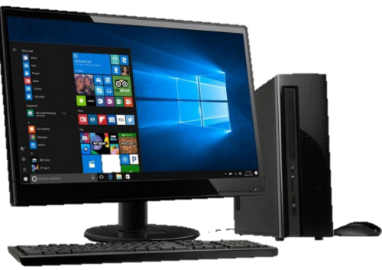
What do you need?
Supported by
A PC or a Mac
Powerpoint or Keynote
A headset combining headphones with a microphone.

Slide 3
Prepare your presentation
Supported by
Prepare your slides as you usually would before adding your narration.
You can add:
Text
Images
Videos
IMPORTANT:
Presentation maximum duration: 15 minutes

Slide 4
Some details about images and videos
Before adding your narration, it is better to check:
The images quality;
The videos quality;
In addition, if you add videos to your presentation, check the compatibility of the video format and codec with Powerpoint or Keynote (a presentation test will be helpful)

Slide 5
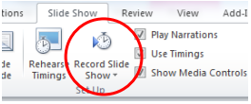
Add your narration
Supported by
Powerpoint:
Use Record Slide Show feature and select one of the following:
Start Recording from Beginning, or
Start Recording from Current Slide.
To end your slide show recording, right click the slide, and then click End Show.
Save the file as .pptx and as MPEG-4 video
The recorded slide show timings are automatically saved and the slide show appears in Slide Sorter view with timings beneath each slide.
Tips:
Be careful: do not talk during transition from one slide to the other.
If you have videos embedded, the slide duration will be equal to the video duration, at least.
Preview the narration: in normal view, click on the sound icon

Slide 6
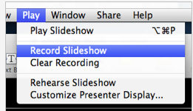
Add your narration
Supported by
Keynote:
From the Play menu choose Record Slideshow.
Starting from the first slide, click on the registration icon e start recording the narration , and play the slideshow, manually advancing the slides where you want them to change. Keynote will record the time when you change each slide.
At the end of the registration, Save the file.
Tips:
Be careful: do not talk during transition from one slide to the other.
If you have videos embedded, the slide duration will equal to the video duration, at least.
Preview the narration: in normal view, click on the play icon

